Slide 1
User Experience Design
Contextual Analysis
Presentation by,
Nitin Malave

Slide 2
Table of Content
Contextual Analysis
Introduction
Flow Model & Work Activity Note
Work Activity Affinity Diagram(WAAD)
Data Interpretation
Example

Slide 3
Contextual Analysis
Contextual analysis is the systematic analysis Identification,sorting,organization, interpretation,consolidation, and communication—of the contextual user work activity data gathered in contextual inquiry, for the purpose of understanding the work context for a new system to be designed.

Slide 4
Introduction
Contextual Analysis Is Data Interpretation
According to Beyer and Holtzblatt (1998), contextual analysis consist of user work activity data interpretation, consolidation, and communication.
Interpretation of raw work activity data is accomplished through:
building a flow model and
synthesizing work activity notes
Data consolidation and communication are accomplished by respectively:
Building a work activity affinity diagram (WAAD) from the work activity notes.
Walkthroughs of all these work products.

Slide 5
Flow Model & Affinity Diagramming
A flow model is a diagram giving the big picture or overview of work,emphasizing communication and information flow among work roles and between work roles and system components within the work practice of an organization.
An affinity diagramming is a hierarchical technique for organizing and grouping the issues and insights across large quantities of qualitative data and showing it in a visual display, usually posted on one or more walls of a room.

Slide 6
Work Activity Note
A work activity note is used to document a single point about a single concept, topic, or issue as synthesized from the raw contextual data.Work activity notes are stated as simple and succinct declarative points in the user’s perspective.

Slide 7
Work Activity Affinity Diagram(WAAD)
A work activity affinity diagram (WAAD) is an affinity diagram used to sort and organize work activity notes in contextual analysis, pulling together work activity notes with similarities and common themes to highlight common work patterns and shared strategies across all users.
Creating an Affinity Diagram
Step 1 - Generate ideas
Step 2 - Display ideas
Step 3 - Sort ideas into groups
Step 4 - Create header cards
Step 5 - Draw finished diagram

Slide 8
What you need to get started?
You will need a big room with plenty of wall space, dedicated for the duration of the project.
You need to be able to leave the work up on the walls over an extended period of time; it will be difficult and disruptive to have to move to another room in mid-process.
Tape up a large“belt” of butcher paper or similar around the walls of the room (Curtis et al., 1999) as a working space for posting work activity notes.
Make sure you have in hand the huge stack of work activity notes.
Line up the players, the WAAD team. You will need about two people per 100–150 work activity notes, as the goal will be to complete the WAAD in a short time (1 to 1½ days).

Slide 9
Look for diversity in the WAAD team members. Definitely include the original user researchers and note takers, include analysts, designers,and other members of your broader team, and include some who would not have ordinarily gotten involved until later.
If there are still empty slots on the WAAD team, spread them around among other stakeholders and others whom you would like to be exposed to the process.
However, you would typically not include the rest of the design team because you will use them in the WAAD walkthrough in the next step.
Appoint one of the original interviewers or note takers as leader or moderator to manage the process and the people, and to keep the WAAD building on track.

Slide 10
Continued..
The larger the group, the more leadership and moderation needed. Sometimes other “natural” leaders emerge within the team doing the affinity diagram.
This is acceptable as long as the others are allowed to take initiative and have an equal say in things. However, intervention may be required if a self-appointed leader becomes too dominating

Slide 11
Advantages of WAAD Diagram
Benefits of the Process
The affinity diagram process is simple and cost effective. The process does not work well for short lists, but when there are many ideas generated from a brainstorming session this process can be used to create focus and determine priorities,some of the benefits are as follows:
Innovative thinking: new thoughts based not based on past ways of conducting business
Transparent: everyone involved has input in process
Open Dialogue: Disagreements about priorities are part of the process

Slide 12
Work Role
A work role is defined and distinguished by a corresponding job title or work assignment representing a set of work responsibilities.A work role usually involves system usage, but some work roles can be external to the organization being studied.
Two important things about contextual analysis:
Contextual analysis does not directly yield either requirements or design.
You probably have to do much of your data interpretation separately for each of the work roles.

Slide 13
Data Interpretation
The first point tells us that this data interpretation step is not an interpretation in terms of requirements or design.
This step of contextual analysis is to pull meaning and depth of understanding from the raw user work activity data.
Data interpretation allows the team to broaden the connections in raw data, which connect one or two team members with a few users,to connect all team members with all interviewees through sharing and discussion
The essence of data interpretation is reviewing, analyzing, and discussing the raw user work activity data. A flow model is constructed.Work activity notes are produced from raw user data and tagged by source and type.

Slide 14
Continued..
Your interpretation of data will be used in the next visits to the customer/ users to check the accuracy of your understanding with the next interviews and observations.Show your data to the customer and users to get their confirmation(or not) and discussion, and look for new data to fill holes.

Slide 15
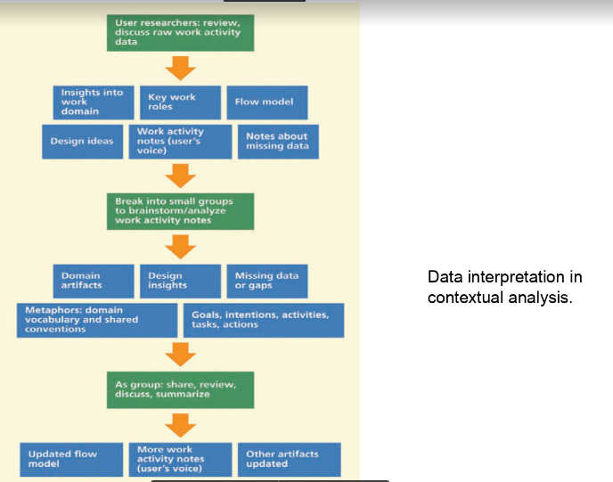

Slide 16
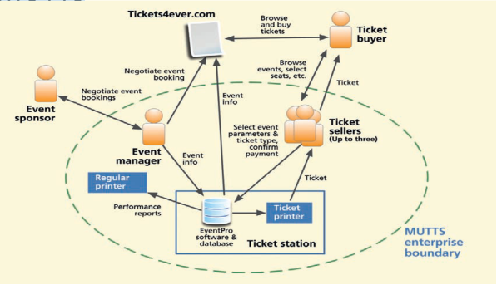
Example: Sketching the Flow Model for MUTTS

Slide 17
Thank You

